Slide 1

T. Enrollment No : T24012011123 Name : Prajapati Yash M. Branch : CE Batch : 1CE-B-3 Class : 1CE-B
Introduction

Slide 2
Introduction To Game Development

Slide 3
6 Stages of Game Development
01
02
03
04
05
06
Concept and Pre-production
Design of Game
Production of Game
Alpha and Beta Testing of Game
Launch of Game
Post-production and Maintenance of Game

Slide 4
01
Concept and Pre-production

Slide 5
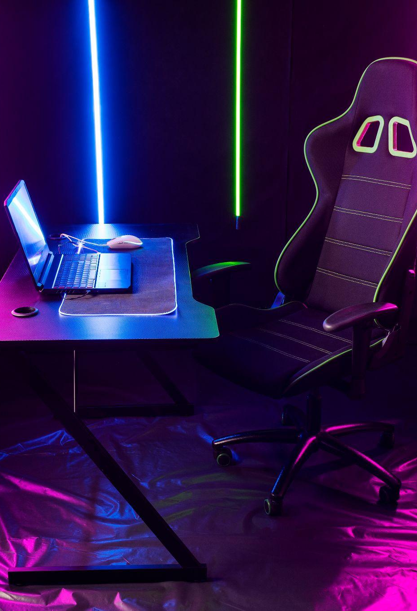
Concept and Pre-production
Concept: This is where the idea for the game is born. Developers brainstorm game mechanics, storylines, and unique features.
Pre-production: Planning begins in earnest. This includes creating a game design document (GDD), defining the scope, outlining budgets, and setting timelines. Early prototypes or proofs of concept might be developed to test core ideas.

Slide 6
02
Design of Game

Slide 7
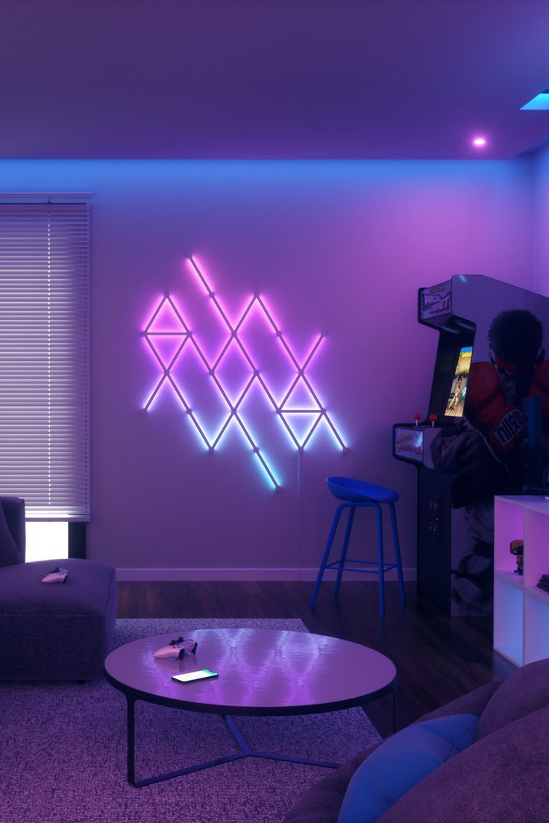
Design of Game
Detailed Design: The game’s mechanics, rules, story, characters, and levels are fleshed out in detail. This stage includes creating detailed design documents and storyboards.
Technical Design: Decisions about the technical aspects of the game are made, including the choice of game engine, programming languages, and other tools.

Slide 8
03
Production of Game

Slide 9
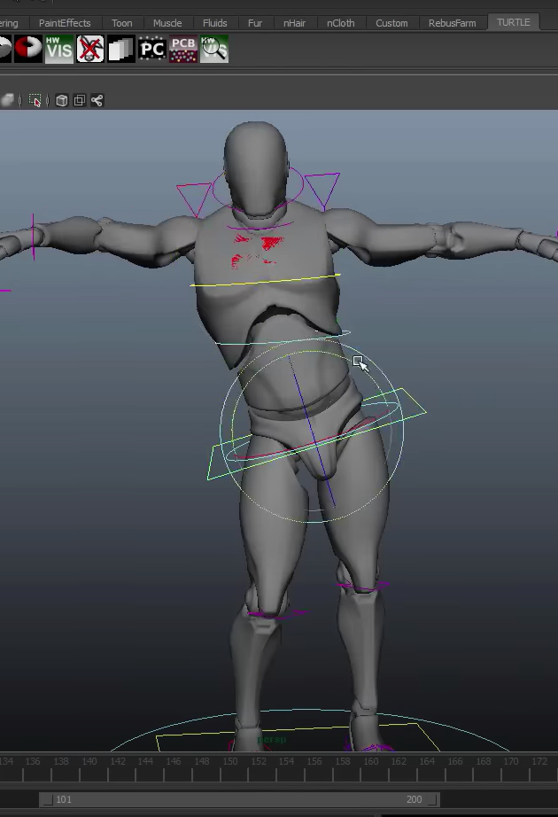
Production of Game
The phase where the actual game development occurs. This involves coding, creating art assets, sound, and integrating all elements into the game. Development happens in iterations with frequent internal testing and refinement.
Development and Coding: Implementing gameplay mechanics, systems, and features through programming.
Art and Asset Creation: Designing and integrating visual elements, including characters, environments, and animations.
Audio Production and Integration: Creating and incorporating sound effects, music, and voiceovers into the game.

Slide 10
04
Alpha and Beta Testing of Game

Slide 11
Alpha and Beta Testing of Game
Alpha Testing
Objective: To identify critical bugs and major issues early in the development cycle, ensuring core gameplay mechanics and functionality are solid.
Participants: Internal team members or a small group of trusted testers, often including developers and quality assurance staff.
Scope: The game may be incomplete with placeholder assets; the focus is on testing fundamental systems, core features, and integration.
Feedback and Iteration: Feedback is used to address major issues and make significant changes; the game undergoes several iterations based on this feedback.
Alpha Testing
Objective: To identify critical bugs and major issues early in the development cycle, ensuring core gameplay mechanics and functionality are solid.
Participants: Internal team members or a small group of trusted testers, often including developers and quality assurance staff.
Scope: The game may be incomplete with placeholder assets; the focus is on testing fundamental systems, core features, and integration.
Feedback and Iteration: Feedback is used to address major issues and make significant changes; the game undergoes several iterations based on this feedback.

Slide 12
Alpha and Beta Testing of Game
Beta Testing
Objective: To gather feedback from a broader audience to refine gameplay, balance, and overall user experience before the final release.
Participants: A larger group of external testers or the general public, which may include dedicated beta testers and early adopters.
Scope: The game is closer to its final form, with most features and content in place. Focus is on assessing overall performance, usability, and identifying less critical bugs.
Feedback and Iteration: Feedback from beta testers helps polish the game, fix remaining issues, and make final adjustments to ensure a smooth and engaging player experience at launch.
Alpha Testing
Objective: To identify critical bugs and major issues early in the development cycle, ensuring core gameplay mechanics and functionality are solid.
Participants: Internal team members or a small group of trusted testers, often including developers and quality assurance staff.
Scope: The game may be incomplete with placeholder assets; the focus is on testing fundamental systems, core features, and integration.
Feedback and Iteration: Feedback is used to address major issues and make significant changes; the game undergoes several iterations based on this feedback.

Slide 13
05
Launch of Game

Slide 14


Launch of Game
The game is prepared for release, including marketing, distribution, and finalizing production for various platforms. This stage involves coordinating with retailers or digital platforms and making sure everything is in place for a successful launch.
Marketing and Promotion: Creating buzz and excitement through advertising, trailers, and community engagement.
Distribution and Release: Making the game available on platforms and coordinating the release schedule.
Post-Launch Support: Addressing immediate issues with patches and providing ongoing player support.

Slide 15
06
Post-production and Maintenance of Game

Slide 16
Post-production and Maintenance of Game
Bug Fixes and Patches
Objective: To address and resolve any bugs or issues that players encounter after the game’s release.
Activities: Monitoring feedback, identifying problems, and releasing updates to fix critical issues and improve game stability.
Content Updates and Expansions
Objective: To keep the game fresh and engaging by adding new content and features after the game’s release.
Activities: Developing and releasing additional levels, characters, or game modes, and creating expansions or downloadable content (DLC) to enhance the player experience.
Community Engagement and Support
Objective: To maintain a positive relationship with players and address their concerns to give them better game experience.
Activities: Engaging with the gaming community through forums, social media, and customer support, and gathering feedback to guide future updates and improvements.
Alpha Testing
Objective: To identify critical bugs and major issues early in the development cycle, ensuring core gameplay mechanics and functionality are solid.
Participants: Internal team members or a small group of trusted testers, often including developers and quality assurance staff.
Scope: The game may be incomplete with placeholder assets; the focus is on testing fundamental systems, core features, and integration.
Feedback and Iteration: Feedback is used to address major issues and make significant changes; the game undergoes several iterations based on this feedback.

Slide 17
Game Engine
A game engine helps developers build games by providing all the tools they need to create graphics, sound, and gameplay in one place.

Slide 18

Most Populer Game Engines
I. Unreal Engine
Overview: Unreal Engine is renowned for its high-end graphics and advanced tools, making it ideal for AAA games and high-fidelity projects. It features powerful rendering capabilities and the Blueprint visual scripting system, which simplifies complex coding tasks.
Examples:
1. Wuthering Waves
2. Fortnite
3. Bloodborne
4. Sea Of Thieves
5. The Witcher 3: Wild Hunt

Slide 19

Most Populer Game Engines
II. Unity
Overview: Unity is a widely-used, versatile game engine known for its user-friendly interface and support for both 2D and 3D game development. It offers a comprehensive asset store and strong cross-platform capabilities, making it popular among indie developers and large studios alike.
Examples:
1. Genshin Impact
2. Pokémon Go
3. Rust
4. Among Us
5. Super Mario Run

Slide 20

Most Populer Game Engines
III. GoDot Engine
Overview: Godot is an open-source game engine that supports both 2D and 3D game development. It is known for its lightweight nature, flexibility, and no royalty fees. It has an active community and offers a range of tools for diverse game types.
Examples:
1. Hollow Knight (Early Development)
2. A Short Hike
3. Hyper Light Drifter
4. The Last Door
5. Kingdoms Reborn

Slide 21
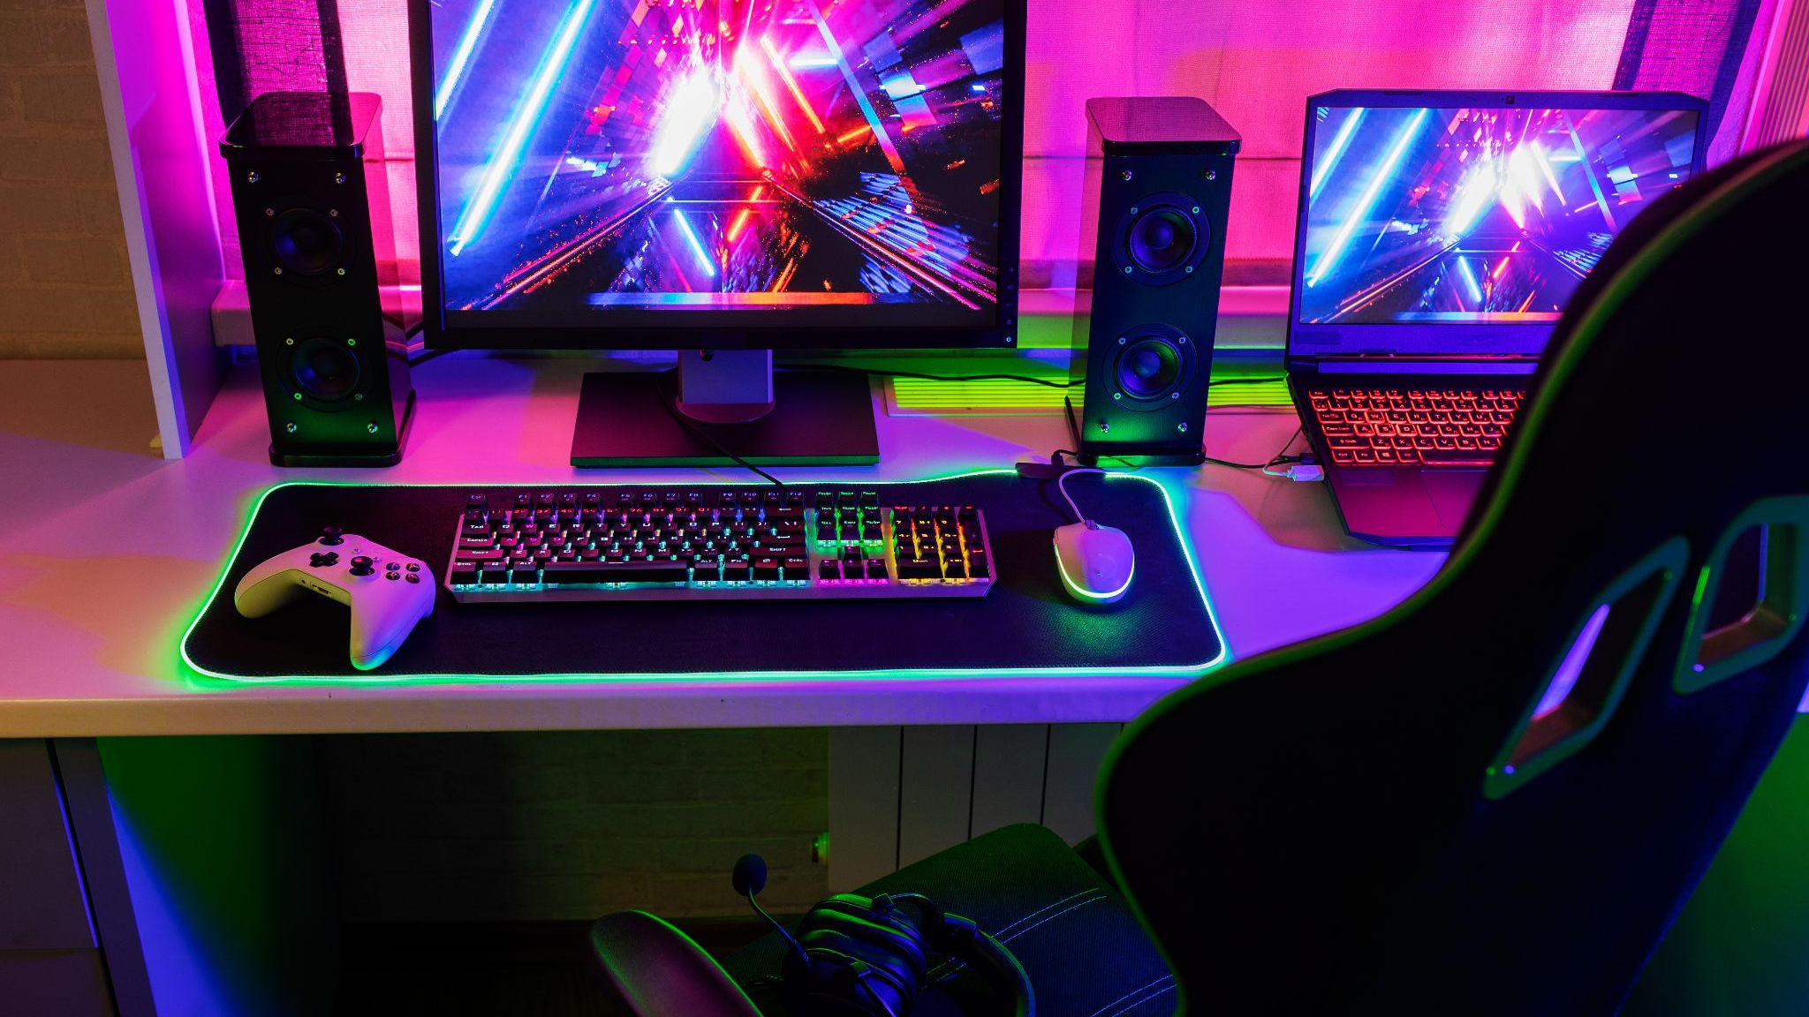
Nobody in this industry knows what they're doing, we just have a gut assumption.

Slide 22
